Slide 1
Capstone Project - 3
HEALTH INSURANCE CROSS SELL PREDICTION
Team members :
Rohit Meshram
Rahul Gayakwad
Rutuja Hingankar
Prashik Ingle
Narayan Borde

Slide 2

Content
Introduction
Problem statement
Data summary
Exploratory Data Analysis (EDA)
Feature Engineering & Selection
Building and Evaluating Model
Conclusion

Slide 3
Introduction
An insurance policy is an arrangement by which a company undertakes to provide a guarantee of compensation for specified loss, damage, illness, or death in return for the payment of a specified premium. A premium is a sum of money that the customer needs to pay regularly to an insurance company for this guarantee.
Just like medical insurance, there is vehicle insurance where every year customer needs to pay a premium of certain amount to insurance provider company so that in case of unfortunate accident by the vehicle, the insurance provider company will provide a compensation (called ‘sum assured’) to the customer.

Slide 4
Problem Statement
Our client is an Insurance company that has provided Health Insurance to its customers now they need your help in building a model to predict whether the policyholders (customers) from past year will also be interested in Vehicle Insurance provided by the company.
Building a model to predict whether a customer would be interested in Vehicle Insurance is extremely helpful for the company because it can then accordingly plan its communication strategy to reach out to those customers and optimise its business model and revenue.
Now, in order to predict, whether the customer would be interested in Vehicle insurance, you have information about demographics (gender, age, region code type), Vehicles (Vehicle Age, Damage), Policy (Premium, sourcing channel) etc.

Slide 5
Dataset Description
id : Unique identifier for the Customer.
Gender : Age of the Customer.
Age : Gender of the Custome
Driving License :0 for customer not having DL, 1 for customer having DL.
Region Code :Unique code for the region of the customer.
Previously Insured:0 for customer not having vehicle insurance, 1 for customer having vehicle insurance.
Vehicle Age :Age of the vehicle.
Vehicle Damage :Customer got his/her vehicle damaged in the past. 0 : Customer didn't get his/her vehicle damaged in past
Annual Premium :The amount customer needs to pay as premium in the year.
Policy Sales Channel : Anonymized Code for the channel of outreaching to the customer ie. Different Agents, Over Mail
Vintage :Number of Days, Customer has been associated with the company.
Response :1 for Customer is interested, 0 for Customer is not interested.

Slide 6
BASIC EXPLORATION
The dataset contains 381109 rows and 12 columns.
Outliers present in all numerical features
Data formating steps required for datetime features
No null values present
Id, Age, Driving_License, Previously_Insured, Vintage and Response are having integer value.
Response , Annual_Premium and Policy_Sales_Channel are having float values
Drop duplicate value
changing categorical value to numerical values

Slide 7


















































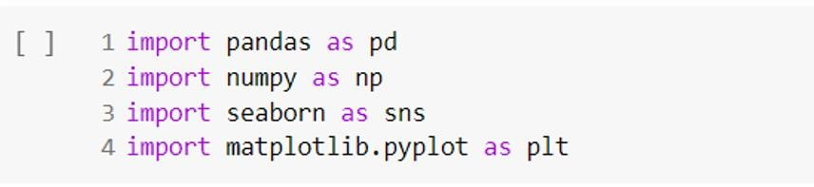
Import Libraries
Library is a collection of related modules. It contains bundles of code that can be used repeatedly in different programs. It makes python programming simpler and convenient for the programmer.
Importing Requrie Libraries

Slide 8
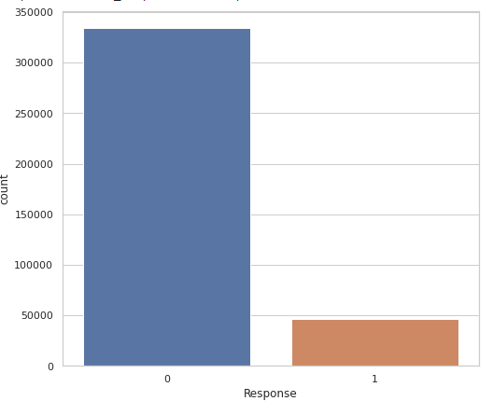
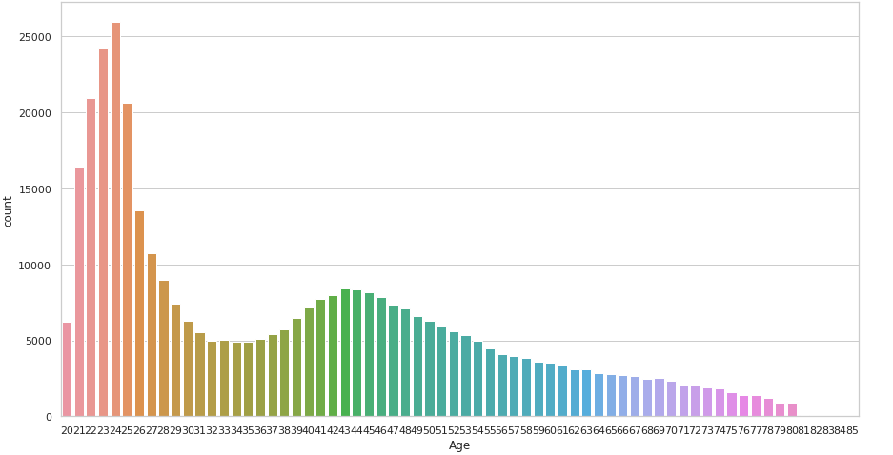
Univariate Analysis
From above fig we can see that the data is highly imbalanced.
From the above distribution of age we can see that most of the customers age is between 21 to 25 years.There are few Customers above the age of 60 years.

Slide 9
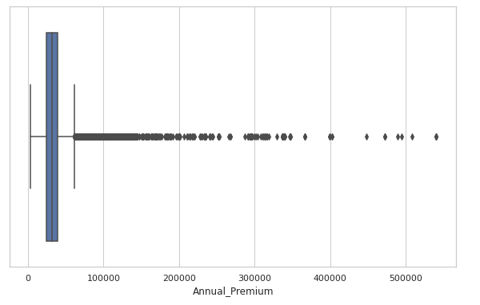
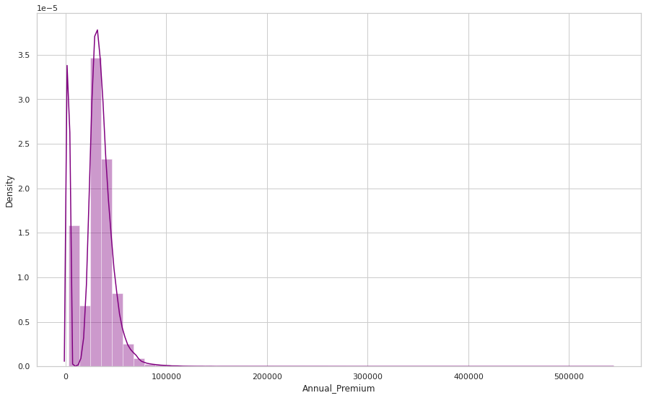
Univariate Analysis
From the distribution plot we can infer that the annual premimum variable is right skewed
For the boxplot above we can see that there's a lot of outliers in the annual premium.

Slide 10
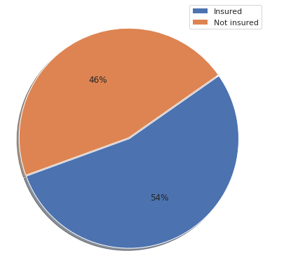
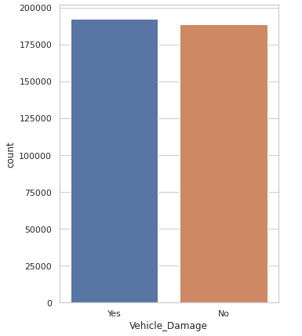
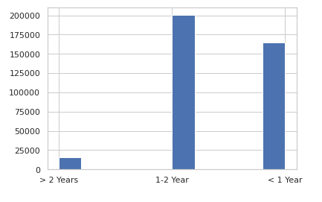
Univariate Analysis
54% customer are previously insured ahe 46% customer are are not insured yet.
Customer who are not perviosly insured are likely to be inetrested.
Customers with Vehicle_Damage are likely to buy insurance
From the above plot we can see that most of the people are having vehicle age between 1 or 2 years and very few people are having vehicle age more than 2 years.

Slide 11
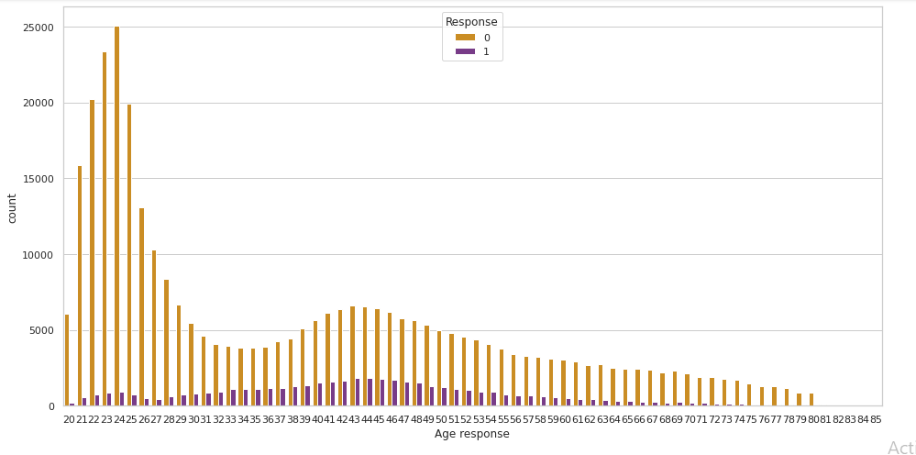
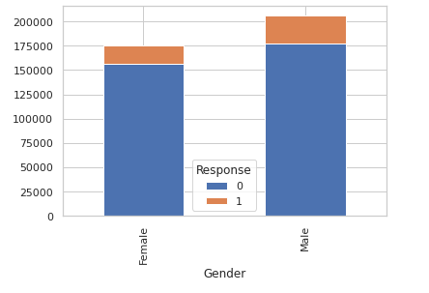
Bivariate analysis
People ages between from 31 to 50 are more likely to respond.
while Young people below 30 are not interested in vehicle insurance.
Male category is slightly greater than that of female and chances of buying the insurance is also little high

Slide 12
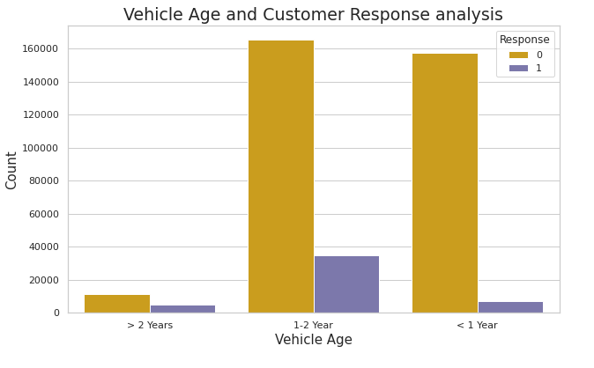
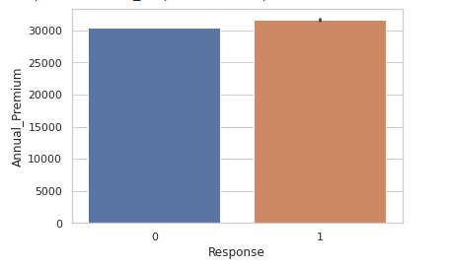
Bivariate analysis
Customers with vechicle age 1-2 years are more likely to interested as compared to the other two
Customers with with Vehicle_Age <1 years have very less chance of buying Insurance
People who response have slightly higher annual premium

Slide 13
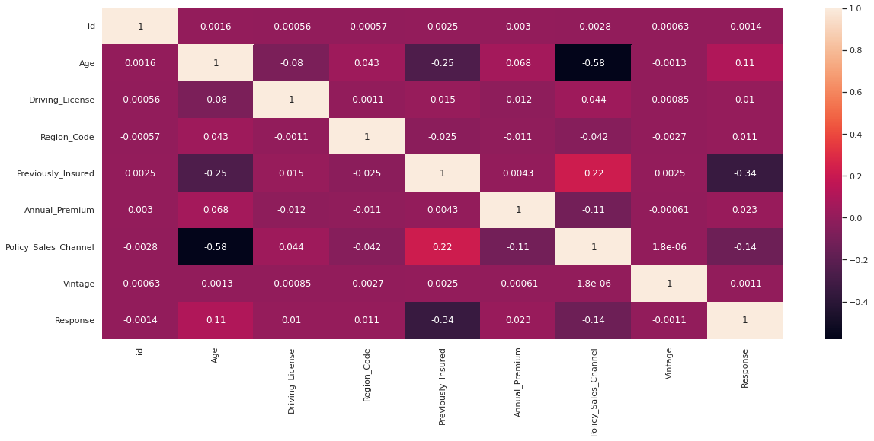
Correlation

Slide 14
Evaluation Metrics
Evaluation metrics are used to measure the quality of the statistical or machine learning model. Evaluating machine learning models or algorithms is essential for any project. There are many different types of evaluation metrics available to test a model.
Why We require Evaluation Metrics?
Most beginners and practitioners most of the time do not bother about the model performance. The talk is about building a well-generalized model, Machine learning model cannot have 100 per cent efficiency otherwise the model is known as a biased model. which further includes the concept of overfitting and underfitting.
It is necessary to obtain the accuracy on training data, But it is also important to get a genuine and approximate result on unseen data otherwise Model is of no use.
So to build and deploy a generalized model we require to Evaluate the model on different metrics which helps us to better optimize the performance, fine-tune it, and obtain a better result.
If one metric is perfect, there is no need for multiple metrics. To understand the benefits and disadvantages of Evaluation metrics because different evaluation metric fits on a different set of a dataset.

Slide 15
Model Building
We can clearly see that there is a huge difference between the data set.
Standard ML techniques such as Decision Tree and Logistic Regression have a bias towards the majority class, and they tend to ignore the minority class. So solving this issue we use resampling technique.
For modeling, we tried the various classification algorithms like:
Logistic Regression
RandomForest Classifier
XGBoost

Slide 16
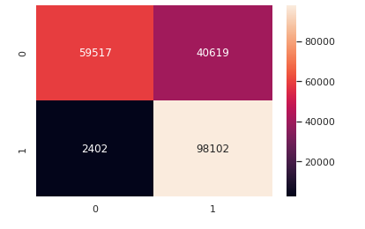
Logistic Regression
Logistic regression is named for the function used at the core of the method, the logistic function.
The logistic function, also called the sigmoid function, was developed by statisticians to describe properties of population growth in ecology, rising quickly and maxing out at the carrying capacity of the environment. It’s an S-shaped curve that can take any real-valued number and map it into a value between 0 and 1, but never exactly at those limits.
A way to evaluate the results is by the confusion matrix, which shows the correct and incorrect predictions for each class.

Slide 17
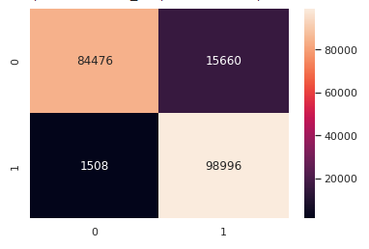
RandomForest Classifier
A random forest is a meta estimator that fits a number of decision tree classifiers on various sub-samples of the dataset and uses
averaging to improve the predictive accuracy and control over-fitting. The sub-sample size is controlled with the
Parameter if bootsrap=True otherwise whole data set build in each tree

Slide 18
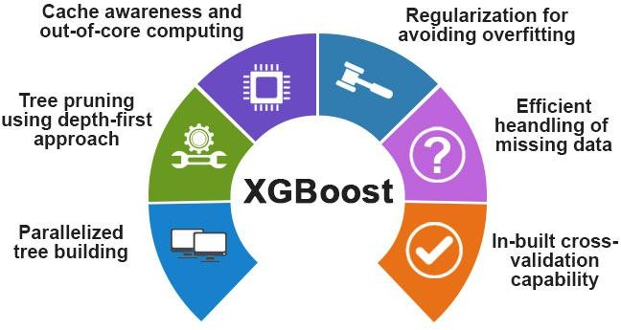
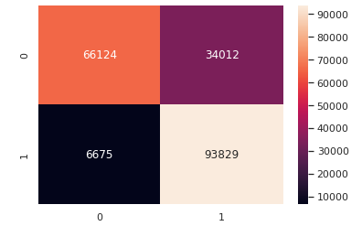
XGBoost
XGBoost comes under boosting and is known as extra gradient boosting.
GBM first calculates the model using X and Y then after the prediction is obtain.
It will again calculates the model based on residual of previous model
loss function will give more weightage to error of previous model. and this process continuous until MSE gets minimizes.
XGBoost is just an extension of GBM with following advantages.
Regularization
Parallel Processing
High Flexibility
Handles Missing values
Tree pruning
Buitin cross validation
Continuous on existing model

Slide 19
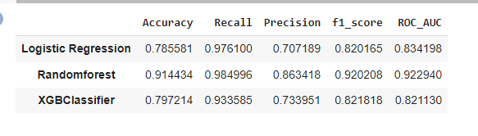
Comparing the Model
Further, we applied Machine Learning Algorithms to determine whether a customer would be interested in Vehicle Insurance.For the logistic regression we got an accuracy of 78% and for the XGBClassifier we got the aacuracy of 79% whereas,.We are getting the highest accuracy of about 91% and ROC_AUC score of 92% with random forest So, From this we can conclude that random forest is the best models as compare to the other models.

Slide 20

Challenges Faced
Handling Large Dataset
Feature Engineering
Computation Time
Optimising The Model

Slide 21
Conclusion:
Through Exploratory Data Analysis,we observed that customers belonging to youngAge are more interested in vehicle response.while Young people below 30 are not interested in vehicle insurance. We observed that customers having vehicles older than 2 years are more likely to be interested in vehicle insurance. Similarly, customers having damaged vehicles are more likely to be interested in vehicle insurance.
The variable such as Age, Previously_insured,Annual_premium are more afecting the target variable.
We observed that the target variable was highly imbalanced.So this issue was solved by using Random Over Sample resampling technique.
we applied feature scaling techniques to normalize our data to bring all features on the same scale and make it easier to process by ML algorithms.

Slide 22
Thank you

